Slide 1
Badging employability and user perceptions: evidence from examples of practice (BEAUPEEP) project
Exploring Student, staff and employer perspectives on digital badging
Image with thanks to Scott Gustavson

Slide 2
The Aims of this project
RQ1. How are open digital badges awarded for student employability valued by A) students, B) employers, C) module teams?
RQ2. How do Open University students use digital badges earned on OpenLearn and Open Badge Factory?
RQ3. How can badging be developed in a way which is fit for purpose in terms of student and employer needs, and curriculum and delivery systems at the Open University?
RQ4. What opportunities might badging offer students to integrate and articulate their learning across qualifications?
RQ5. What role can badging play in strategies for inclusion and retention as well as enhanced employability?

Slide 3
What are open digital badges?
Open because…these badges can be shared by recipients beyond the organisation offering them, for example on their CVs or social media to demonstrate their achievements
Digital because…this is how they are offered to the learners
Badges because…they have a logo and some information as to what they have been offered for (like pin badges)
For example, a badge gained as part of involvement in this project was for Evidence café (advocation of voice) event participation.
To gain this badge, participants will have contributed by:
Reading the information about the event
Providing consent for participation in the event according to own preferences
Attending the event as previously agreed with the organiser
Engaging with the event discussions
Providing opinions as relevant to the aims of the event
Offering reflections as part of the evaluation of the event

Slide 4
OVERALL design and timescale
Phase 1
Design & Desk based research
Sept to Dec 2021
To address RQs 1, 3 and 5
Evidence cafés¹ involving employers, students, staff
Mar and Apr 2022
To address RQs 1-5
Phase 2
Survey – employers, students, staff
Jan to Apr 2022
To address RQs 1,2 and 5
Phase 3
Phase 4
Analysis and reporting
Jun to Nov 2022
¹What is an evidence café?
Clough, G. and Adams, A. (2016 1st ed)(2017 2nd ed) Evidence Café How To Guide, Centre for Policing and Research, Open University
www.open.ac.uk/blogs/ResearchEssentials/wp-content/uploads/2017/11/Evidence-Cafe-HowTo-Guide-A5-V12.pdf
Papathoma, T. (2020) Virtual Evidence Cafés amid COVID-19; guidance on how to run one, 20 April 2020
https://aktinaki.wordpress.com/2020/04/02/virtual-evidence-cafes-amid-covid-19-guidance-on-how-to-run-one/

Slide 5
DESK BASED STUDY findings
Alison Fox with thanks to Amanda Smith

Slide 6
Student perspectives on open digital badging (RQ1a)
There is very little published research related to the student perception of DBs as an employability tool
What there is relates to DBs supporting ‘extra-curricular’ activities rather than embedded within formal, taught modules:
10 recent studies have been identified.

Slide 7
StAFF perspectives on open digital badging (RQ1b)
The limited research on the staff perspective of DBs is usually about their use generally as opposed to their role in employability.
However, offer insights into assessing the impact of DBs
4 studies and evidence from 9 University websites found

Slide 8
StAFF perspectives on open digital badging
Issues identified similar to those of students re: possible lack of credibility but staff appear less enthusiastic
Lack of awareness & concerns that gimmicky, mean less likely to be prepared to invest time and hence only pockets of enthusiasm and badge development within institutions
Staff were interested in using DBs to track student progress. Potentially if not earned could be used as an alert for the need to make an intervention (Harvey, 2017, )

Slide 9
employer perspectives on open digital badging (RQ1c)
Very little known about the employer perspective.
3 studies identified

Slide 10
employer perspectives on open digital badging
Employers have very similar perceptions about DBs to students.
If there is an ‘impasse’ of badges not being ‘used by employers,’ learners are unlikely to pursue them’ (Ahn et al. 2014)
Attaching value and credibility to DBs can only be achieved if students, staff and employers understand the benefits and limits to DBs and know how to use them effectively.
Credibility may be mitigated by developing credentialling systems, and co-design across stakeholder sectors would be beneficial. Further developments are needed.

Slide 11
How can badges be made fit for purpose? (RQ3)
Raising awareness will help promote the credibility of DBs, so need stakeholder involvement from the outset: student, staff and employer.
Taking a student led approach is exemplified e.g. DBs driven by Students' Associations at the Universities of Edinburgh, Stirling and Dundee (Anderson et al. 2017).
Ensuring the purpose of the DB drives its design, and progression inbuilt to create manageable milestones (Carey and Stefaniak 2018). Dyjur and Lindstrom (2017)
Putting effort into graphic design will help promote credibility, communication of purpose and needs to be inclusive. Recommend codesign (MacKinnon 2021)
Developing strong partnerships between HEAs and employers (Perkins and Pryor (2021) .
Balancing pedagogical digital badge practice with employer needs, with clear curriculum outcomes, robust communication strategies and clear and precise badge detail (Leaser et al. 2020).

Slide 12
SURVEY findings
With thanks to the leadership of Terry O’Sullivan

Slide 13
Survey background
Three separate surveys aimed at employers, staff and students
Recruited via OU contacts, internal HR and student panel respectively
Some common questions; some specific to anticipated interests
Used JISC Online Survey tool
Respondents: employers 31; staff 90; students 117

Slide 14
Students on badges (RQ1a)
26.5% agreed they might distract from main study priorities (similar % to staff)
Appropriate uses question got mixed responses, including ‘Employability skills, instead of wasting module space and TMA marks on it’
Concern about limited external understanding and awareness: ‘People generally don’t know what to make of badges’

Slide 15
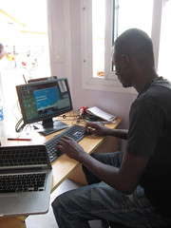
Staff on badges (RQ1b)
25% could not see relevance to current role
8% already using them
‘Future uses’ got lots of ‘don’t know/non-committal’ but:
35.5% agreed on need for a framework for badges
36.4% agreed with use in formal qualifications
37.4% agreed with use for extra-curricular skills
Suggested uses: employability, disaggregated prerequisites, stage awards, collaborative awards with industry lead bodies.

Slide 16
Employers on badges (RQ1c)
71% don’t currently use badges in recruitment or staff development
Universities seen as much less important than other providers such as professional bodies and industry leading companies over the next three years (though a large degree of ‘don’t know/non-committal’ on this)
Orientation in open-ended comments to badges pointing to evidence of achievement. If awarded ‘simply for a quiz pass or isolated example of a competence then it’s going to be no more useful than any other claim made by an applicant on their CV’

Slide 17
EVIDENCE CAFÉs
Alison fox with thanks to Lilybell evergreen, Fi Moorman, Eleanor Crabb, Lina AdInolfi, Abiola George and Vicky Murphy

Slide 18
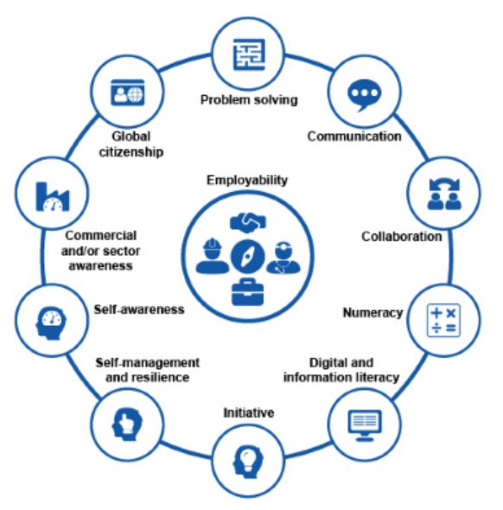
In relation to the Open University Employability framework (and RQ2) …

Slide 19
…What kinds of evidence are valuable? Focused on four skill areas…

Slide 20
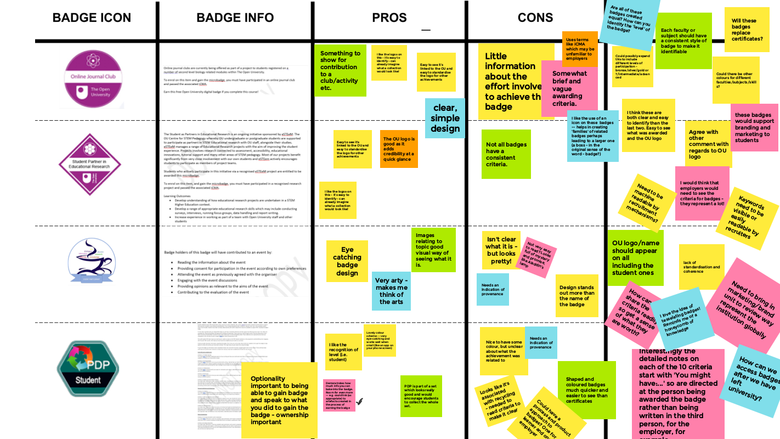
Discussion object 1

Slide 21
RQ3. In relation to OU examples, How can badging be developed in a way which is fit for purpose in terms of student and employer needs, and curriculum and delivery systems at the Open University?
Eclectic mix even from one institution
Do the different shapes mean anything particular?
Institutional logo very important to link to organisational brand/reputation
If endorsed by another organisation would increase value and endorsement would need to be easily seen
To help employer access when recruiting…Can the baked-in criteria be captured by text recognition software? Can a weblink provide overview of badges and what they mean?

Slide 22
RQ4. What opportunities might badging offer students to integrate and articulate their learning across qualifications?
Skills awards and Uberbadges to be built across the University to offer coherent offer across AND beyond University study
Could offer suites of badges at different levels to show progression
Can link to frameworks - such as the JISC digital capabilities tool, the OU employability framework, databases of job descriptions - to match against learning outcomes/badge criteria
Needs strategic offer and staff collaboration across Faculties and across qualifications
Is a place for within-course skill development opportunities to be mapped for students against these beyond-course badges
Staff to look for opportunities to automate evidence of participation to allow this to operate at scale eg completion yes/no, streak of activity on website, self-set goals of what would be appropriate
Need to overcome problems in assessing competence and whether proxies considered sufficient
Facilitating students to reflect on skill development needs scaffolding and tools to go beyond what can be easily measured eg PDP and peer mentoring, blogging

Slide 23
STAFF, STUDENTS AND EMPLOYERS AGREED THAT…
Badges are desirable for learners
Badges can articulate what skills students have gained from engaging in badged activity. They can be general or specific
Employers see digital badging as a new phenomenon and might not all be ready to accept badges as evidence of skills
Students, staff and employers would appreciate discussion about the currency of these badges, with so many experiences and activities related to them.
Employers would need information about badges to justify deploying resources to investigate the value of a badge during recruitment
Evidence of the origin of a badge through the institutional logo adds value to it
A consistent approach is needed to digital badging across an institution and across the sector
Having a bigger picture helps students, staff and employers understand the value of badges
Details of individual badges and what they mean need also to be communicated to students, staff and employers

Slide 24
STAFF, STUDENTS AND EMPLOYERS AGREED THAT…
Clarity is needed about the audience for badges – are they for personal satisfaction and/or external uses?
There are often more uses for badges than those they are designed for, as students are likely to vary in their motivations for working towards badges
Badges can be a focus for telling narratives about ourselves to ourselves and/or our peers as well as when applying for study, voluntary work or employment.
Employers can use digital badge achievement as a useful talking point at interview to gain more knowledge about applicants’s skills and experience.
Too many badges will be counterproductive to recruitment. A badge needs to stand out for something exceptional for an employer to be interested
Badges such as the ones designed in this project can be useful in encouraging participation in consultations and events
Badges can be used to generate a sense of community amongst those who achieve. They have the potential to be inclusive.
Badges can also be motivational and generate a sense of competitiveness which could be useful for achieving study goals

Slide 25
Recommendations and deliverables

Slide 26
Recommendations …
Advertise
Raise awareness of the purpose and potential of badges - for employability, community building, personal interest, motivation/retention
Offer
Offer a wide range of badges showing choice, connectivity and progression
Advertise
Communicate the content of badges and the criteria in meaningful ways, including year and valid to date if relevant
Support
Support students in making the most of their badges, including mechanisms for making the badges and their criteria visible eg LinkedIn
Advertise
Capture at a glance how badges fit into a bigger picture of badge delivery - at module, programme, School, Faculty and University levels
Design
Design for credibility and validity, including mechanisms for checking badge criteria are of value, have been met and include OU logo
Check
Ensure badge criteria are fully inclusive and ensure criteria can be feasibly met by all
Promote
Consider how to increase badge criteria visibility to employers eg key terms in criteria, scanning of CVs and other AI solutions
Consider
Consider multiple languages in design, use and promotion
Think about
Think about how we can contribute to evaluating digital badges across the sector

Slide 27
KEY mESSAge: Overcome Lack of awareness
By students of what is available, how to gain them and how to use them
By staff of their potential and how their roles could contribute to offering or supporting badge achievement
By employers of what they tell them about recruiting employees

Slide 28
deliverables
Desk-based review
Seminar led for the OU Employability Scholarship Network on including visitors from Nottingham Trent University
Presentation as part of the employability and badging for the OU/Nottingham Trent University Employability Conference
Input report to the setting up of the OU Digital Badging Steering Group from the BEAUPEEP leads
Presentation to the OU Future of interdisciplinary teaching and learning at the OU conference
Scilab blog post on ‘Badge Attitude’
The creation of 3 Evidence Café badges (for organisers, facilitators and participants) in OBF for 2022-2023 to hand over to OpenLearn
To host on ORDO- a) a recorded presentation b) an edited project report c) the desk-based review and presentation d) the survey tools
Presentation to Arden Open University as part of their QUEST open seminar series, due on 28/11/22
Presentations to the Edinburgh College Research and Innovation Network at two stages to educators across Scotland
Briefing paper to CES team at University of York
Image with thanks to Business Review.edu

Slide 29
IMPACT

Slide 30
IMPACT: instrumentally to practice and policy
To the new OU Digital Badging Steering Group led by Patrina Law
Informing discussions in the CES team, particularly regarding the Employability Award (which includes a digital badge), and actions agreed for 2022-2023.
Digital badging generated in the project to be used in ECYS, funded by the Student Voice and Wellbeing Group, and a new Student Ambassador badge created.
A FBL-WELS pilot has been submitted to the Digital Badging Steering Group to combine the PDP/employability badges and issue through OpenLearn
Discussions with the PRAXIS director to feed into development of digital badges through OpenLearn for student partnership in research and scholarship.
Contributing feedback to materials and processes within the student internship scheme.
Refocused team members on ways of gathering evidence linked to criteria, eg, informing consultancy with student doctors at the Leeds Institute for Medical Education.
Support for the creation and communication of internship digital badges by the Careers and Employability (CES) team

Slide 31
IMPACT: CONCEPTUALLY to awareness and understanding
The desk-based review increases awareness of work to date on digital badging and employability and informed stages 2 and 3 of the project.
To audiences of presentations given as workshops internally and externally (see deliverables for details) with opportunity for participation and debate and during evidence cafés
Through opportunities for debate amongst a core team of 4 staff and 4 students, an additional team of 25 staff and students communicating through a MS TEAMS channel including collaborative piloting of instruments and monthly newsletters to share emerging findings.
Through a mailing list of 27, mainly students and employers, registered to receive the final project outcomes.
Making resources available on ORDO to an open audience, using # tags to increase chance of searchability.
Inputs to OU-wide groups thinking about digital badging ie. Community and Sense of Belonging Task and Finish group led by Karen Foley, Student Mentoring Task and Finish Group (phases I and II) led by Tina Forbes.
Developing team members’ readiness to spot badging opportunities in Higher Education eg briefing for colleagues in the University of York’s CES informing their graduate employability programme 'York Strengths’

Slide 32
IMPACT through capacity building by increasing skills
Promoting skills development was an integral part of the project for all participants and team members.
Recognition of skill development was digitally badged. 7 Evidence café facilitators, including two students, were trained in the creating and running online Evidence Cafes, including one who did not participate in the project but wanted to lead Evidence Cafés elsewhere and evidence café events.
The student intern worked through the digital badge criteria for Evidence Café event organisation and was awarded the digital badge.
An alumni acted as peer mentor for the student intern and was awarded a Peer Support digital badge.
9 Participants claimed their Evidence Café participant badges recognising their contributions and skills gained during the evidence cafés.
Co-leads skill development - in across-University project bidding, planning and approval. Terry O’Sullivan in particular in using the JISC survey package

Slide 33
IMPACT attitudinally or culturally
This impact is harder to capture in the project from the data collected.
Indications of patterns of attitude and badge behaviours are captured in the survey findings above.
The OU Digital Badging Steering Group will take on this work.

Slide 34
IMPACT As enduring connectivity
By team members now being part of the Digital Badging Steering Group
Despite Edinburgh College Research and Innovation Network link to the OU leaving and a new Chair in place, have invited members of the BEAUPEEP team invited to review the strategy for the network
FBL and ECYS via the PDP/employability badges are now working on a pilot. New colleagues are involved beyond the BEAUPEEP team and original modules involved.
Cementing strong working partnerships between internal colleagues across the participating faculties and across academic, technical and professional areas.
Recruiting alumni and industry participation provides opportunities for future work in this area with these contacts.

Slide 35
IMPACT on student experience
Raising awareness to staff and students of how digital badging can recognise skill development important in supporting student learning
Increasing awareness to staff of how digital badging can recognise additional skills and experiences beyond the core curriculum which offers added value to module study
Raising staff awareness of opportunities for collegiality and/or competitiveness which can contribute to student sense of belonging and/or motivation and hence retention
Making visible and adding to understanding of what evidence would be considered valued by students, staff and employers in relation to the OU employability framework
Starting to raise awareness with employers of the existence and potential value of looking for and asking students about digital badges, to be explored further by CES.
Providing a catalyst within CES to share awareness of the range of digital badges available and informing new extra-curricular badging such as the Employability Award.
Exploring ways within CES to support students who have engaged with digital badges to effectively articulate what they have gained.

Slide 36
THANK you very much for your interest in our project. For everyone contributing We have very much appreciated your views
For any queries, Please email BEAUPEEp@open.ac.uk
Image with thanks to Scott Gustavson

