Slide 1
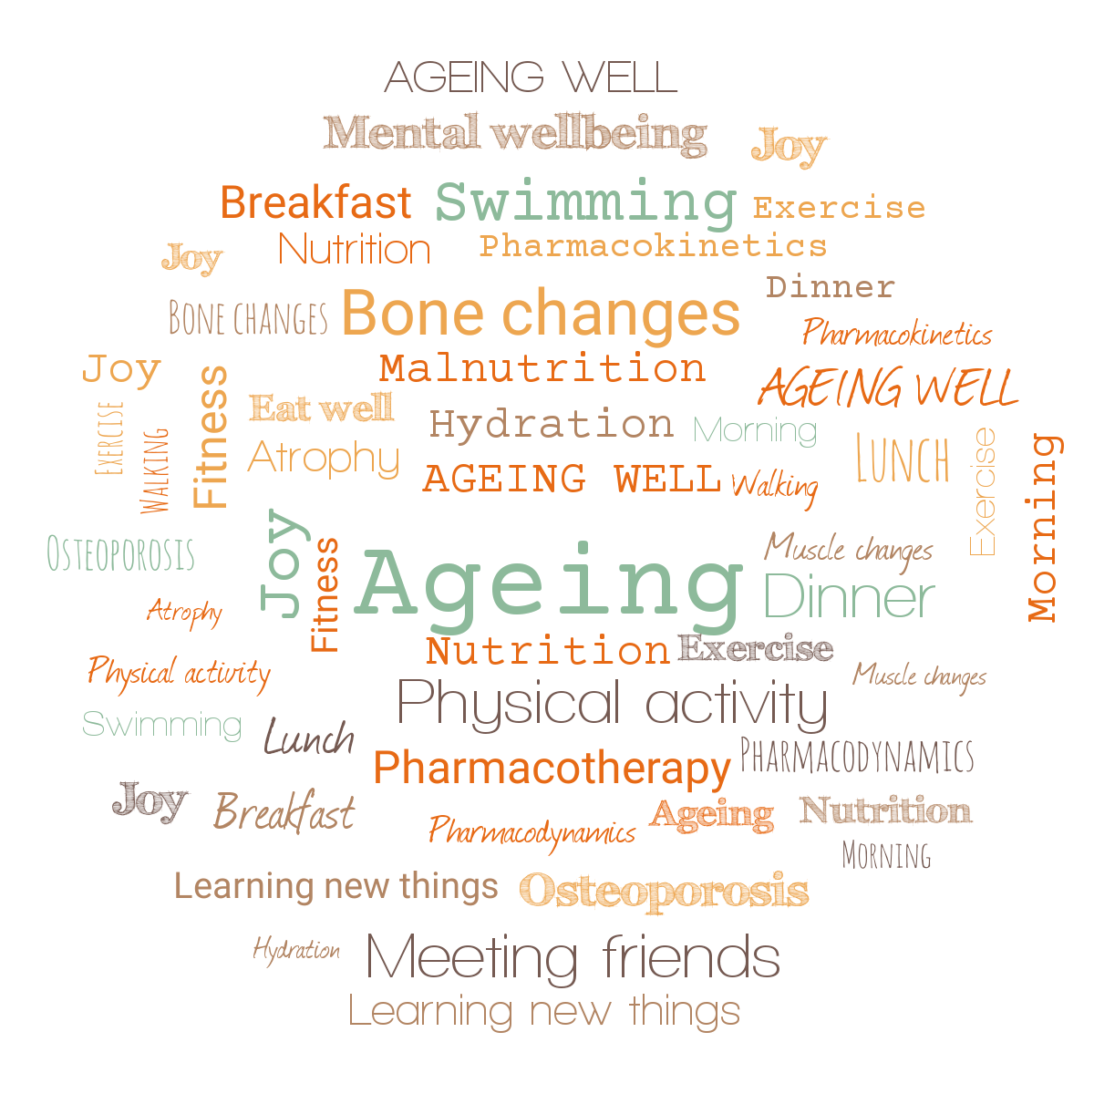

Ageing Well Public Talk Series
2021/22

Slide 2
Talk 1. Are we prepared to live longer?
Dr Jitka Vseteckova, PhD, D.Prof., SFHEA , Senior Lecturer Health, Wellbeing and Social Care
Dr Catherine Pestano, D.Prof., XXXXX
School of Health, Wellbeing and Social Care
Faculty of Wellbeing, Education and Language Studies
The Open University

Slide 3
Why are we here today…
The world population is rapidly ageing.
We are all ageing since the day we are born.
Physical and psychological/cognitive decline that happens at different speeds for different individuals.
Ageing processes are in general very difficult to predict.
Genetic predispositions we may need to take into account regarding the overall ageing the process is also co-defined by what we actually do about it.
USE IT OR LOSE IT - in other words, both cognitive and physical stimulation while ageing, help to preserve cognitive and physical functions we don’t want to lose. Especially during COVID-19 times.

Slide 4
Building bridges – conventions & paradoxes ‘Education is for the young & Internet is full of resources’
The older we get, the more existing schemas and new information we need to assimilate and as when education is combined with experience, then it becomes the most useful knowledge.
The older we get the more needs for education we have. How to stay healthy, how to keep active, how to keep our brains in good shape so that we can enjoy life for longer. This, is not always common knowledge and we grow older we can make good use of it especially when we don’t have easy access to internet and or have hard time finding the right information there.
The internet is full of materials and information - but still not easily accessible (in terms of language, reliability and validity of research) by everyone, particularly people who need this information, older people who may not be very techy.

Slide 5
Ageing well – public talk series
Building bridges
Series of public talks started 16 years ago (as PhD student) – Charles University & Third Age University - developed in collaboration with STOWHEALTH General Practice
Component of an international online education platform for clinicians and allied health professionals (in China) streamed via the UKeMED & Cambridge Medical Academy.
During the ‘Ageing Well’ talks we explore approaches which may enable us to live longer and healthier lives. Theories of ageing, biomedical and psychosocial aspects of ageing, the most common comorbidities, and the ageing brain are some of the concepts that are explored in the series.
‘Five Pillars of Ageing Well’

Slide 7
2020/21 Series plan
Are we prepared to live longer? (Jitka Vseteckova & Catherine Pestano) September 22nd 2021
Advanced Care Planning (Barbara Gale) October 20th 2021
Ageing brain (Jitka Vseteckova & Marco Calabria) November 17th 2021
Learning languages and digital technologies in older age (Ursula Stickler) December 15th 2021
Disenfranchising grief and caring in older age (Kerry Jones) January 19th 2022
Nutritional needs while ageing (Jitka Vseteckova & Alan Hastings) February 23rd 2022
Pharmacotherapy while ageing (Jitka Vseteckova & Sonal Mehta) March 23rd 2022
Mindfulness and ageing (Abigail Methley) April 20th 2022
Move it and breathe (Jitka Vseteckova & Declan Ryan) May 18th 2022
Standing tall (Jitka Vseteckova) June 22nd 2022
The things we don’t talk about – Intimacy and ageing (Andreas Vossler) July 20th 2022
For more information and live streaming links follow:
https://ordo.open.ac.uk/collections/Ageing_Well_Public_Talks_2020-21/5122166

Slide 8
All the way through the ‘Ageing Well’ talks we explore how using this knowledge might facilitate self-management, become partners in our care and delay the ageing processes for as much as we can.
The emphasis of the ‘Ageing Well’ series is on optimizing cognitive and physical well-being, physiological ageing and self-management. To a lesser extent, on pathological processes while ageing.
Promoting physical activity, social activity, networking, learning and healthy lifestyle
Easy stretching during each lecture

Slide 9
Messages to be taken home today
The famous motto about ageing goes as: Use it or lose it! In other words both cognitive and physical stimulation while ageing, help to preserve the functions we don’t want to lose.
Especially in COVID-19 times: ‘Do it today’!
Myths about physical exercise and people who exercise.

Slide 11
STANDING UP / SITTING DOWN
Raising up principle - STRAIGHTENING YOUR SPINE
Proprioception – feeling different parts of your feet on the floor
Slightly pressing the inner side of your foot to the floor
Stretching your toes
Pushing yourselves away from the ground
Moving head or arms should not necessarily change the way we stand

Slide 12
Ageing & Epidemiology – basic facts
The world’s population is rapidly ageing.
Within the next five years, for the first time in human history, the number of adults aged 65 and over will outnumber children under the age of 5.
Ageing processes bring a decline in physical and cognitive domain. This decline proceeds at variable speed for different organs and different individuals. This is why the ageing in general is so difficult to predict.

Slide 13
There are some genetic predispositions that may slightly speed up or slow down the ageing processes or show us what we need to be aware of in terms of age related conditions in our predecessors.
However, the genetic predisposition does not affect 100% of how our ageing might look like especially if we decide to help it.
Ageing is a process and this process starts when we are born, therefore ageing does not affect us only from 60 or 65 years onwards (although most often discussed age cut off when it comes to ageing – just manifesting faster)

Slide 14
Ageing well has become increasingly important also because we live older for longer
The majority of epidemiologic studies have found slower rates of cognitive and physical decline among those who routinely engage in more cognitively and or physically demanding tasks compared to those with a more mentally and physically sedentary lifestyles.
Nutrition, hydration, physical, social & cognitive stimulation (includes learning) – five pillars of ageing well
The way we live our lives will affect the way we age – Are we ready to make those choices?

Slide 16
Basic biomedical aspects of ageing
Ageing processes bring about decline to which we try to adapt
Ageing influences the decline of organs and tissues as well as whole systems
The way our organs age is different for each and every one of us
The way the systems age is different for each and every one of us
Main influences:
Genetics
Epigenetics

Slide 17
Genetics – are we victims of our genes?
Increases/may increase the predisposition to certain types of diseases or conditions
We cannot change the genetic set we have
We still don’t know enough about genetics & how it works
We can get some conditions as our parents and grandparents had but we may also only carry forward the specific gene these conditions are linking to …
We don’t know enough about our predecessors
…but we can influence to some extent if it manifests, how soon and in which way it might manifest
So in other words it often doesn’t so much matter what we have but what we actually do with it

Slide 18
Epigenetics – are we victims of our nurture?
The families we are born into, their habits, their friends and other people and places that surround them, the places and people we surround ourselves with, the habits we form …
Influence of the environment from the day of conception
We have some degree of control over this

Slide 19
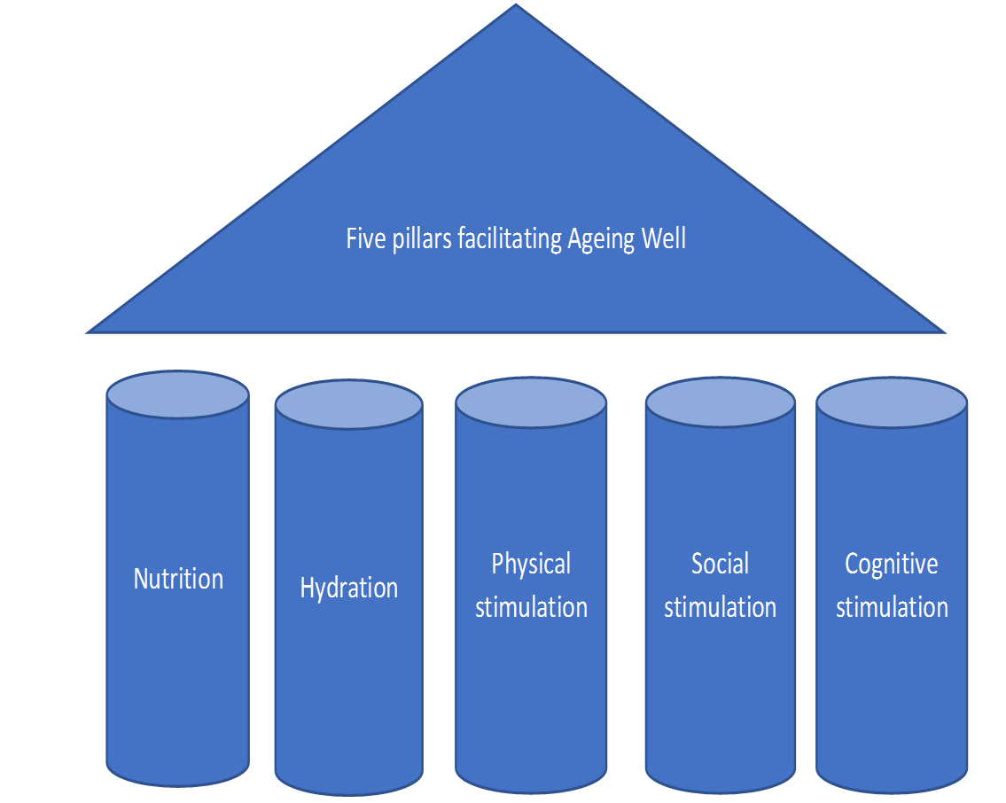
Winners by choice

Slide 20
When physiological processes turn pathological
Physiological ageing equals normal and is expected
“Normal” aging is a result of natural maturational processes and expected part of the ageing process whereas
“pathological” aging is due to non-normative factors such as disease, injury or trauma to the brain.
In these series we will focus mostly on physiological ageing and how we can optimise cognitive and physical ageing.
Physiological can turn pathological

Slide 21
Main theories of ageing
Hayflick limit or Hayflick phenomenon
Wear and tear theories
Oxidative stress
Apoptosis
No matter what ageing theory you work with the changes resulting from ageing processes are at physical, psychological, cognitive and systemic levels

Slide 22
Immune system (is a network of cells, tissues, and organs that work together to defend the body against attacks by “foreign” invaders. These are primarily microbes—tiny organisms such as bacteria, parasites, and fungi that can cause infections (low grade infections)
Self repair mechanisms are also impaired (one of the reasons why cancers happen in later life)
Nervous system (is a complex network of nerves and cells that carry messages to and from the brain and spinal cord to various parts of the body. Proprioception example – develop linking Central nervous system and Peripheral nervous system (tripping over an obstacle as a delayed response from the brain)
Endocrine system The endocrine system is the collection of glands of an organism that secrete hormones directly into the circulatory system to be carried towards distant target organs

Slide 23
Chain of hormones e.g thyroxine, diabetes and insulin and pancreas, testosterone, (estrogen and osteoporosis)
Musculoskeletal system – muscle atrophy, bone fragility, tendon & joint stiffness,
Cardiovascular system – veins and arteries, atherosclerosis and ageing, regularity of circulation (brain, other organs, respiratory system etc)
Lifestyle is crucial
‘Five pillars of ageing well’

Slide 25
Cognitive ageing – tiredness of our systems
Diminished ability to remember names, find the correct word, remember where objects are located, concentrate
Is this “normal”? Yes
Ageing Brain talk (17th November 2021)
Tiredness of our systems – when young we have it too but we can sleep it off – not so easy while ageing as many things come together

Slide 26
Stress management
Lifestyle – some of the changes could be slowed down (Five Pillars to Ageing Well)
Cognitive sphere influences physical and vice versa
Physical wellbeing is affected by worsening mental wellbeing and vice versa
Exercise improves our sleep
Important to do it all when we are still well

Slide 28
STANDING UP / SITTING DOWN
Raising up principle - STRAIGHTENING YOUR SPINE
Proprioception – feeling different parts of your feet on the floor
Slightly pressing the inner side of your foot to the floor
Stretching your toes
Pushing yourselves away from the ground
Moving head or arms should not necessarily change the way we stand

Slide 29
Healthy bones vs Osteoporosis
Osteoporosis is a condition of fragile bone (increased porosity of the bone)
Osteoporosis weakens bone and increases risk of bones breaking
Low levels of physical activity, malnutrition, smoking, decreased levels of calcium and other minerals, menopause / andropause - decrease of hormones
Bone mass (bone density) starts decreasing after 35 years of age, and bone loss occurs more rapidly in women after menopause.
Manifests via back pain, sometimes decrease in height, decreased mobility
Physical activity, nutrition, hydration, supplementation of vitamin D (D3 – active form – calcium binding protein)

Slide 30
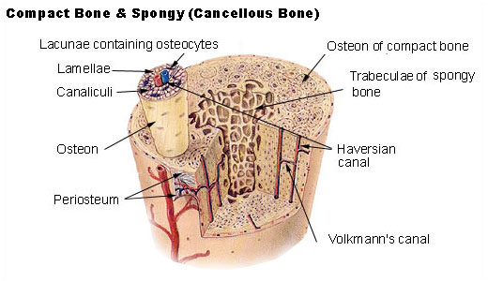
Osteoporosis

Slide 31
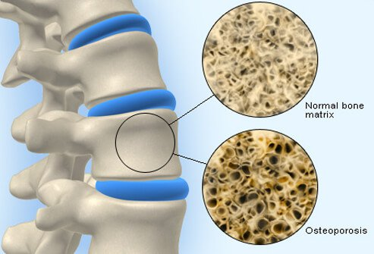

Slide 32
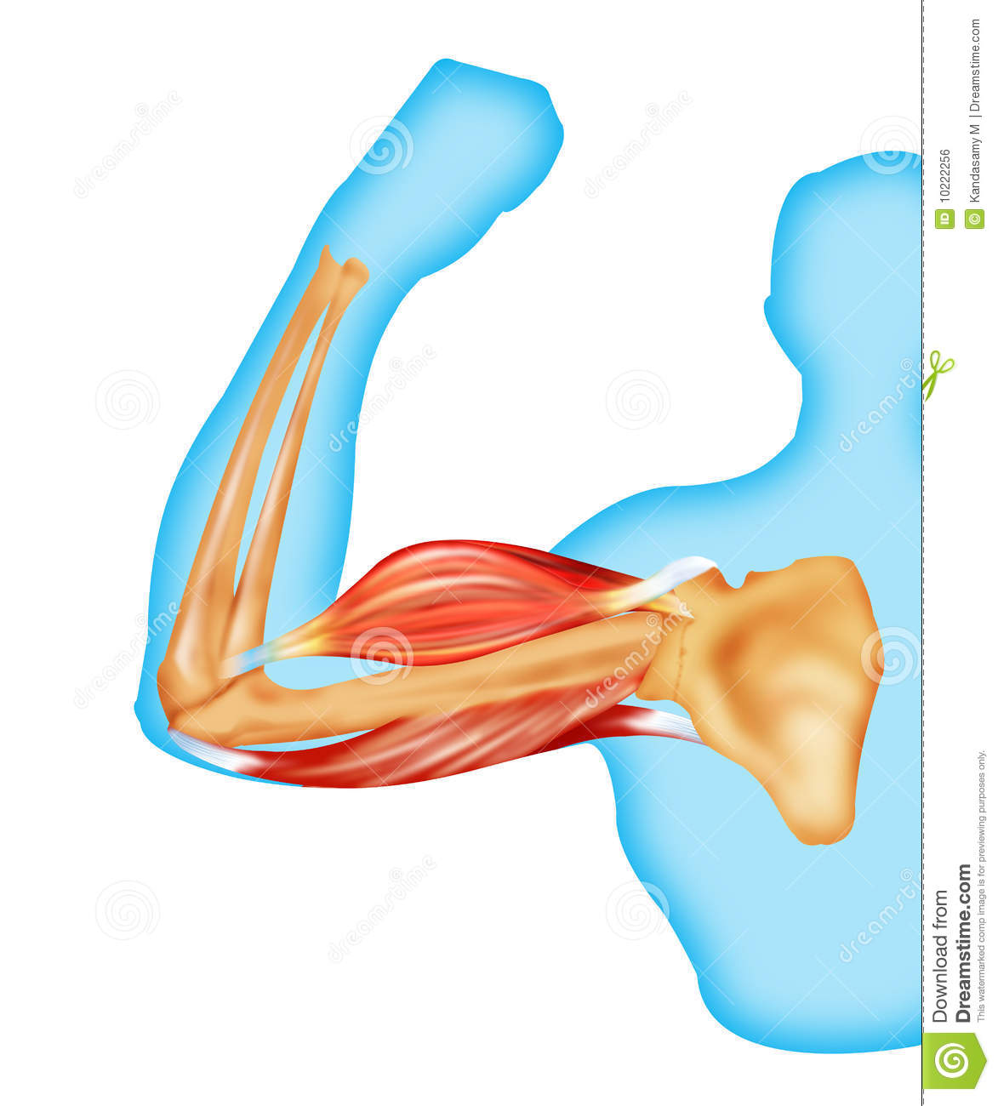
Bone is very important as it protects internal organs, creates support for the body, muscles are attached to it
Healthy bone is very important to healthy ageing
Muscle atrophy is a big problem while ageing as it affects directly our postural stability, mobility and falls and also bones
more details Move it and Breathe (May 2022) & Standing tall (June 2022) talks.

Slide 33
Frailty
In clinical terms, frailty is characterised by loss of biological reserves across multiple organ systems and increasing vulnerability to physiological decompensation after a stressor event.
Loss of resilience that people living with frailty do not bounce back quickly after a physical or mental illness, an accident or other stressful event.
Frailty is a common geriatric syndrome, the overall prevalence of frailty in people aged over 60 is 14% and it tends to be more common in women. 5% of people aged 60-69 have frailty. This rises to 65% in people aged over 90.
Frailty is linked with lack of exercise, poor mobility, difficulty doing Activities of Daily living (ADL), but specially with complications after injuries, illnesses, other accidents or stressful events
Nutrition, hydration, physical, cognitive and social activity/stimulation

Slide 34
Hormonal changes at midlife
These affect many at the midlife transition both directly and indirectly. This talk considers those who identify and women or possibly non-binary, and also those who identify as men.
Changes to the sex hormones in the body can also be brought on early through surgery or a condition. If this is not present those born with ovaries and womb can experience a significant substantial series of changes from 30s (more typically 40s) onwards which give rise to a large range of menopause symptoms, affecting every aspect of living.

Slide 35
Many will need hormonal replacement help. Some will be able to manage through lifestyle shifts including diet. For all these elements will support wellbeing and health through this long transition.
How long? Possibly 2 year, many experience up to 15 years and some experience till the end of their lives.
Main symptoms might include:
Physical – exhaustion, genito-urinary & atrophy, joint pain, excessive bleeding, palpitations, bone loss, dry eye, tinnitus, burning tongue, restless legs
Emotional – anxiety, depression, flatlining, anger, mood flux, tears, rage, irrational fear, fluctuating mood
Cognitive/Psychological – brain fog, sleeplessness, sensory overload, hard to concentrate
Relational – family, work, sexual responsiveness/libido loss

Slide 36
Onset is varied
Treatable – Systemic and localised Hormonal replacement therapy (HRT) as a first response, along with T4 thyroid testing and testosterone.
Over 45 - diagnosis by symptoms only.
Lifestyle changes, especially around ‘Five Pillars for Ageing Well’ to reduce stress and renegotiate social roles, along with medical interventions. Many women need help and find it hard to get.

Slide 37
Andropause
Though not paralleling women’s intensity of experience, men can have hormone changes at this time of life, with negative or positive impacts.
A key difference is that testosterone decline is gradual not sudden. Negative symptoms such as depression, lethargy, loss of sex drive can be treated with replacement hormones. However these are often unrelated to hormones, more to society’s attitudes to men.
Help can be offered for existential or lifestyle related negative symptoms, through therapy, CBT, diet, exercise.

Slide 38
Thank you for joining today & questions
Jitka & Catherine
jitka.vseteckova@open.ac.uk & catherine.pestano@open.ac.uk
http://www.open.ac.uk/people/jv2595
https://ordo.open.ac.uk/collections/Ageing_Well_Public_Talks_2021-22/5493216

Slide 39
Series 2021/22 - 2. Advanced Care Planning
Dr Barbara Gale (CEO, St Nicholas Hospice) 20th October

Slide 40
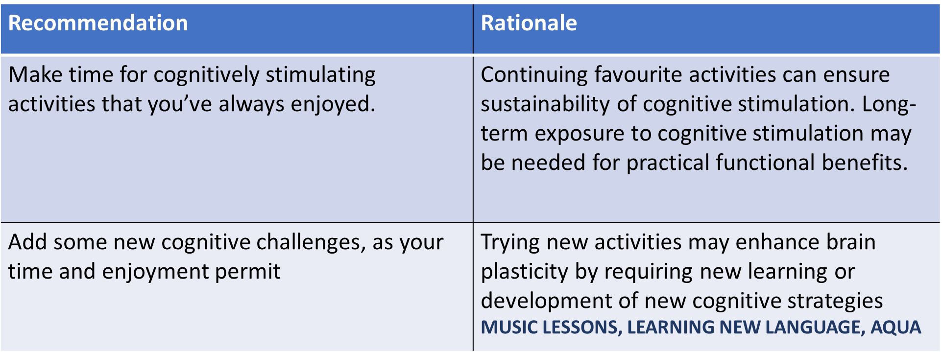
Lifestyles that combine cognitively stimulating activities with physical activities and rich social networks may provide the best odds of preserving cognitive function in old age (La Rue, 2010).
What is your experience?

Slide 41
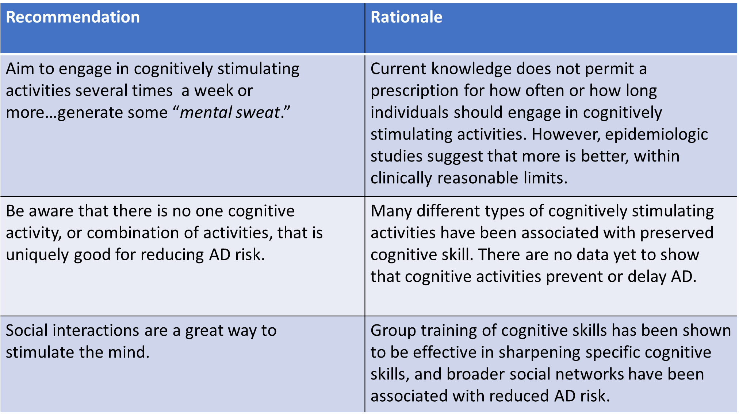

Slide 42
Hormonal midlife changes - resources
International menopause awareness day 18th Oct, use the following resources to raise awareness: https://www.imsociety.org/education/world-menopause-day/
NICE guidance on the menopause https://www.nice.org.uk/guidance/NG23
Pausivity free poster campaign and resources https://www.pausitivity.co.uk/
Dr Louise Newson Free CPD for GP surgeries https://www.menopausedoctor.co.uk/
Activism and magazine https://www.menopausematters.co.uk/
Case law on Henpicked menopause hub https://henpicked.net/menopause-hub/
British Menopause Society https://thebms.org.uk/
Andropause https://www.nhs.uk/conditions/male-menopause/

Slide 43
Summary of related resources to The Ageing Well Public Talk Series
Podcasts
Vseteckova J & King J (2020) COVID-19 Interview podcast for The Retirement Café: ‘Ageing Well Under Lockdown’ https://theretirementcafe.co.uk/077-dr-jitka/
Vseteckova J & Broad E (2020) Keep Me Walking - researching with people living with dementia and their carers - Podcast – Open University in collaboration with The Parks Trust https://youtu.be/0QHAS88C-LU
Vseteckova J (2020) Podcast - areas for research with The Open University https://youtu.be/vE6J9J_ovOM
Broad E & Methley A & Vseteckova J (2021) Podcast OU & The Parks Trust & Northamptonshire Healthcare NHS Foundation Trust - Spotter sheet and mindful walking. https://www.youtube.com/watch?v=dq5OXEBk3CA&feature=youtu.be
Broad E & Methley A & Vseteckova J (2021) Preventing brain decline while ageing https://www.youtube.com/watch?v=965w7K8XPdo

Slide 44
OpenLearn Resources:
Vseteckova J (2020) Ageing Well Public Talk Series https://www.open.edu/openlearn/health-sports-psychology/health/the-ageing-well-public-talks
Vseteckova J (2019) 5 reasons why exercising outdoors is great for people who have dementia https://www.open.edu/openlearn/health-sports-psychology/mental-health/5-reasons-why-exercising-outdoors-great-people-who-have-dementia
Vseteckova J (2019) Depression, mood and exercise https://www.open.edu/openlearn/health-sports-psychology/mental-health/depression-mood-and-exercise?in_menu=622279
Vseteckova J (2019) Five Pillars for Ageing Well https://www.open.edu/openlearn/health-sports-psychology/mental-health/five-pillars-ageing-well
Vseteckova J (2020) Ageing Brain https://www.open.edu/openlearn/health-sports-psychology/health/the-ageing-brain-use-it-or-lose-it
Vseteckova J (2020) Ageing Well Public Talks Series II. Plan for 2020 – 2021 https://www.open.edu/openlearn/health-sports-psychology/health/ageing-well-public-talk-series-plan-2020/2021
Vseteckova J (2020) Walking the Parks with The OU and The Parks Trust https://www.open.edu/openlearn/health-sports-psychology/social-care-social-work/keep-me-walking-people-living-dementia-and-outdoor-environments
Vseteckova J, Borgstrom E, Whitehouse A, Kent A, Hart A (2021) Advance Care Planning (ACP ) - Discuss, Decide, Document and Share Advance Care Planning (ACP ) - Discuss, Decide, Document and Share - OpenLearn - Open University

Slide 45
Vseteckova J, Methley A, Lucassen M (2021) The benefits of mindfulness and five common myths surrounding it https://www.open.edu/openlearn/health-sports-psychology/mental-health/the-benefits-mindfulness-and-five-common-myths-surrounding-it
Vseteckova J, Broad E, Andrew V (2021) The impact of walking and socialising through 5 Ways Café on people living with dementia and their carers: A volunteer’s perspective https://www.open.edu/openlearn/health-sports-psychology/health/the-impact-walking-and-socialising-through-5-ways-cafe-on-people-living-dementia-and-their-carers
Vseteckova J, Methley A, Lucassen M (2021) The benefits of mindfulness and five common myths surrounding it https://www.open.edu/openlearn/health-sports-psychology/mental-health/the-benefits-mindfulness-and-five-common-myths-surrounding-it
Methley A, Vseteckova J, Broad E (2021) Outdoor Therapy: The Benefits of Walking and Talking https://www.open.edu/openlearn/health-sports-psychology/mental-health/outdoor-therapy-the-benefits-walking-and-talking
Vseteckova J, Methley a, Broad E (2021) What happens to our brain as we age and how we can stop the fast decline https://www.open.edu/openlearn/health-sports-psychology/health/what-happens-our-brain-we-age-and-how-can-we-stop-the-decline
Methley A & Vseteckova J & Jones K (2020) Green & Blue & Outdoor spaces https://www.open.edu/openlearn/health-sports-psychology/mental-health/the-benefits-outdoor-green-and-blue-spaces

Slide 46
COVID-19 related
Vseteckova J, How to age well, while self-isolating (2020) https://www.open.edu/openlearn/health-sports-psychology/how-age-well-while-self-isolating
Vseteckova J, (2020) SHORT FILM - Ageing Well in Self-Isolation https://youtu.be/LU4pXFgcGos
Vseteckova J, (2020) ANIMATION - Keeping healthy in Self-Isolation https://youtu.be/M9yUC-MUugA
Vseteckova J et al (2020) COVID-19 The effects of self-isolation and lack of physical activity on carers https://www.open.edu/openlearn/health-sports-psychology/social-care-social-work/the-effects-self-isolation-and-lack-physical-activity-on-carers
Taverner P, Larkin M, Vseteckova J, et al. (2020) Supporting adult carers during COVID-19 pandemic https://www.open.edu/openlearn/health-sports-psychology/social-care-social-work/how-can-adult-carers-get-the-best-support-during-covid-19-pandemic-and-beyond
Robb M, Penson M, Vseteckova J, et al. (2020) Young carers, COVID-19 and physical activity https://www.open.edu/openlearn/health-sports-psychology/social-care-social-work/young-carerscovid-19-and-physical-activity
Penson M, Vseteckova J et al. (2020) Older Carers, COVID-19 and Physical Activity https://www.open.edu/openlearn/health-sports-psychology/social-care-social-work/older-carers-covid-19-and-physical-activity
Vseteckova J & Methley A (2020) Acceptance Commitment Therapy (ACT) to help carers in challenging COVID-19 times https://www.open.edu/openlearn/health-sports-psychology/health/how-can-acceptance-and-commitment-therapy-help-carers-challenging-times-such-the-covid-19-pandemic

Slide 47
‘Ageing Well Public Talks’ Series 2021/2022 repository on ORDO Collections
https://ordo.open.ac.uk/collections/Ageing_Well_Public_Talks_2021-22/5493216
‘Ageing Well Public Talks’ Series 2020/2021 repository on ORDO Collections
https://ordo.open.ac.uk/collections/Ageing_Well_Public_Talks_2020-21/5122166
‘Ageing Well Public Talks’ Series 2019/2020 repository on ORDO Collections https://doi.org/10.21954/ou.rd.c.4716437.v1
OpenLearnCreate Course on ‘Ageing Well’ 2019/2020 https://www.open.edu/openlearncreate/course/view.php?id=5016
Home exercise no equipment – no problem Blog
https://selsdotlife.wordpress.com/2020/04/01/home-exercises-for-older-adults-no-equipment-no-problem/

Slide 48
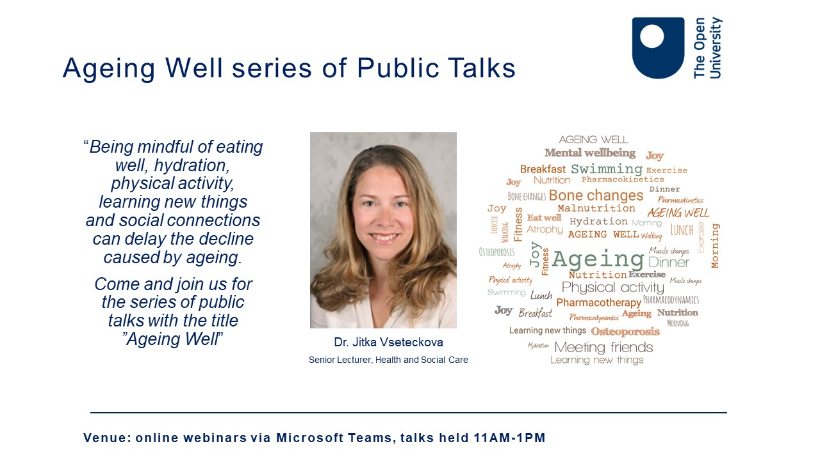

Slide 49
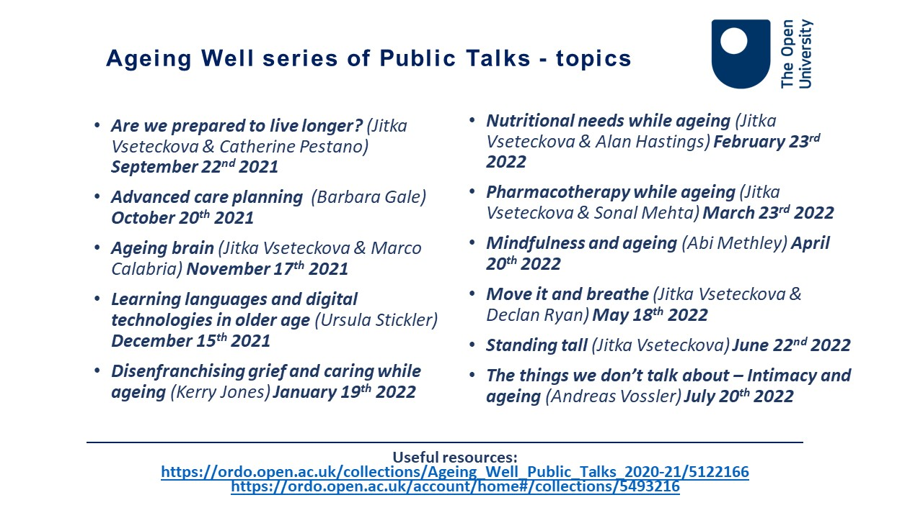

Slide 50
