Slide 1
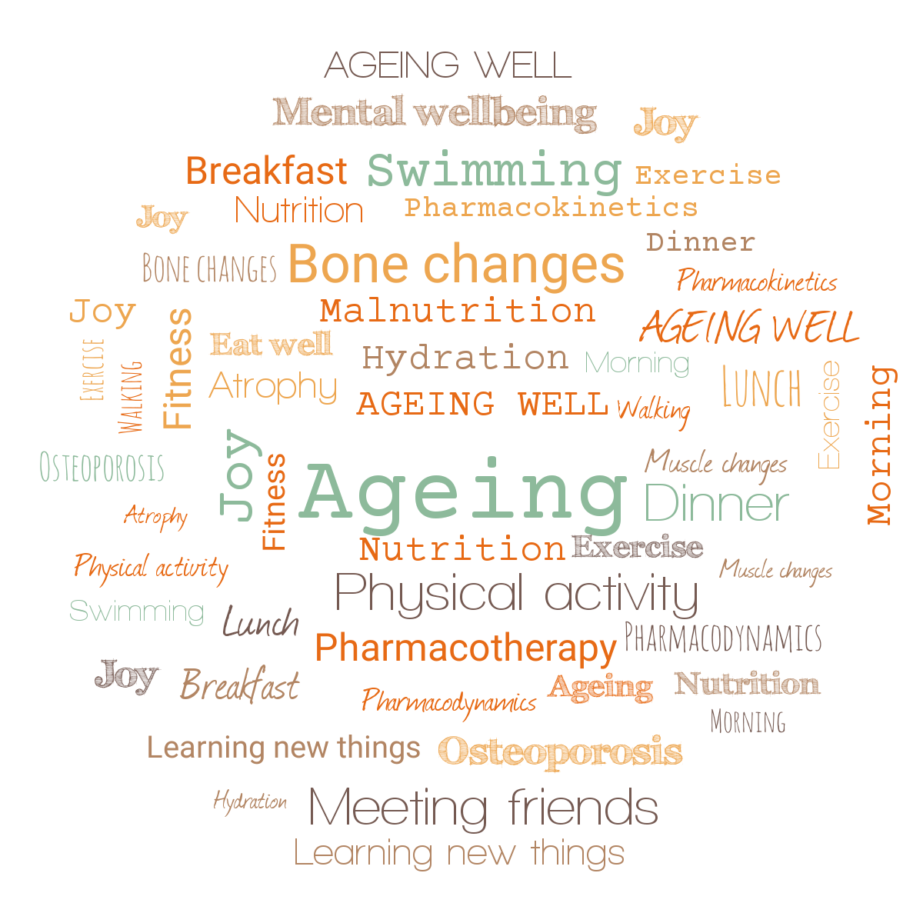




Ageing Well Series
Mindfulness and Ageing
Adele Pacini
Clinical Psychologist and Mindfulness for Later Life Project Lead

Slide 2
2020/21 Series plan
Are we prepared to live longer? (Jitka Vseteckova) September 23rd 2020
Advanced Care Planning (Barbara Gale & Erica Borgstrom) October 21st 2020
Ageing brain (Jitka Vseteckova & Stephanie Warren) November 18th 2020
Learning languages and digital technologies in older age (Ursula Stickler) December 2nd 2020
Care and caring in older age (Mary Larkin) January 20th 2021
Nutritional needs while ageing (Jitka Vseteckova & Alan Hastings) February 24th 2021
Pharmacotherapy while ageing (Jitka Vseteckova & Sonal Mehta) March 24th 2021
Mindfulness and ageing (Adele Pacini) April 14th 2021
Move it and breathe (Jitka Vseteckova & Declan Ryan) May 19th 2021
Standing tall (Jitka Vseteckova & Jason Gibb) June 16th 2021
The things we don’t talk about – Intimacy and ageing (Andreas Vossler) July 14th 2021
For more information and live streaming links follow:
https://ordo.open.ac.uk/collections/Ageing_Well_Public_Talks_2020-21/5122166

Slide 3
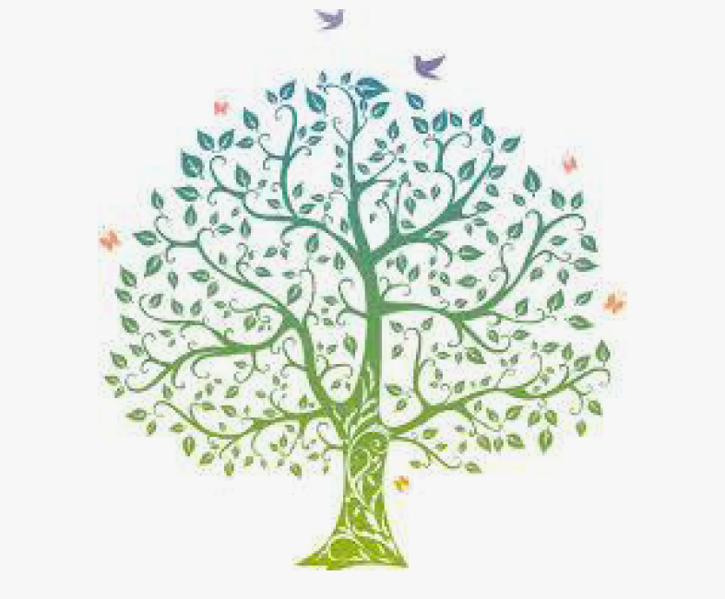
Overview
What is mindfulness?
The three minute breathing space
What is the benefit of it?
How does it work?
Our experience of delivering mindfulness for later life groups
Summary and Questions

Slide 5
Depending on the format, mindfulness works across physical, social and cognitive stimulation levels:
Mindful movement
Attention and memory stimulation
Group delivery

Slide 6
“Why do we practice mindfulness?
…..So you can enjoy your old age.”
Shunryu Suzuki Roshi

Slide 7
The best way to learn about mindfulness is to practice
The three minute breathing space is a brief grounding practice, which was developed to help people anchor themselves in the present moment.
I will guide you through the practice for the next slide.
It is completely optional.
Helpful attitudes to bring to the practice are ones of openness and putting to one side hopes or expectations.
Any questions?

Slide 9
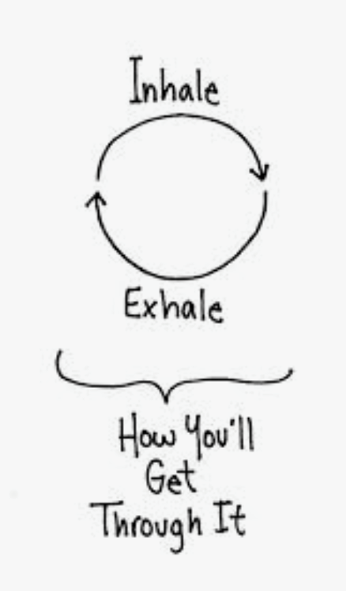
Thoughts/Reflections?

Slide 10
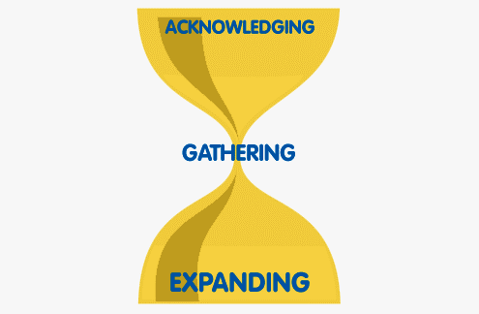
The 3 Step / Minute Breathing Space
1. Acknowledging
Bring yourself into the present moment by deliberately adopting a dignified posture. Then ask: ‘What’s going on with me at this moment? What thoughts, feelings and body sensations am I experiencing right now?
You could put your inner experience into words, for example, say in your mind, ‘A feeling of anger is arising’ or ‘self-critical thoughts are here’ or ‘my stomach is clenched and tense.’
2. Gathering
Gently bring your full attention to the breathing. Experience fully each in-breath and each out-breath as they follow one after the other. It may help to note at the back of your mind ‘breathing in…breathing out’, or to count the breaths. Let the breath function as an anchor to bring you into the present and to help you tune into a state of awareness.
3. Expanding
Expand your awareness around the breathing to the whole body, and the space it takes up, as if your whole body is breathing. Especially take the breath to any discomfort, tension or resistance you experience, ‘breathing in’ to the sensations. While breathing out, allow a sense of softening, opening, letting go. You can also say to yourself ‘it’s ok to feel whatever I’m feeling.’ Include a sense of the space around you too. Hold everything in awareness. As best you can, bring this expanded awareness into the next moments of your day.

Slide 11
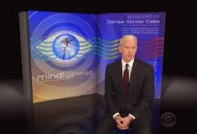
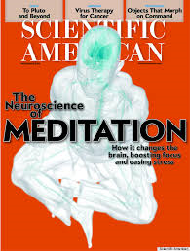
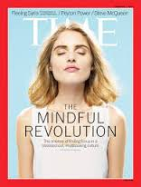
There has been a huge explosion of interest
in mindfulness….

Slide 12
The evidence base typically applies to these courses….
Mindfulness Based Stress Reduction (MBSR) www.umassmed.edu/cfm
Mindfulness Based Cognitive Therapy (MBCT) http://mbct.co.uk/
Breathworks www.breathworks-mindfulness.org.uk
Mindfulness Based Living Course (MBLC) www.mindfulnessassociation.net
Mindfulness Based Childbirth and Parenting (MBCP) www.mindfulbirthing.org
Mindfulness Based Relapse Prevention (MBRP) http://www.mindfulrp.com
These programmes are: Informed by a clear rationale; Teacher-led;
Have been developed to be scalable; Have a set curriculum, typically at least eight sessions with 30 – 45 mins daily home practice, incremental development and experiential learning; and have a clear commitment to be evidence-based.

Slide 13
Training Centres and Regulatory Bodies
UK Network for Mindfulness-Based Teacher Training Organisations setting standards for mindfulness-based teaching www.mindfulnessteachersuk.org.uk
UK Network for Mindfulness-Based Teachers Good practice guidelines for teaching mindfulness-based courses www.mindfulnessteachersuk.org.uk/pdf/UK%20MB%20teacher%20GPG%202015%20final%202.pdf
The Universities of Bangor, Exeter and Oxford Mindfulness-based Interventions Teaching Assessment Criteria (MBI:TAC) www.mindfulnessteachersuk.org.uk/pdf/MBI-TAC%20manual,%20summary%20&%20addendums%2005-16.pdf

Slide 14
Why be mindful?
”In today’s rush we all think too much – seek too much – want to much – and forget about the joy of just being” Eckhart Tolle
“Mindfulness is simply being aware of what is happening right now without wishing it were different.
Enjoying the present without holding on when it changes. (which it will)
Being with the unpleasant without fearing it will always be this way. (which it won’t)”
James Baraz

Slide 15
Mindfulness
Paying attention listening, watching or considering what naturally exists.
On purpose intentionally increasing awareness of experience.
Non-judgementally being curious and objective about experience
In the present moment focusing on the here and now.

Slide 16
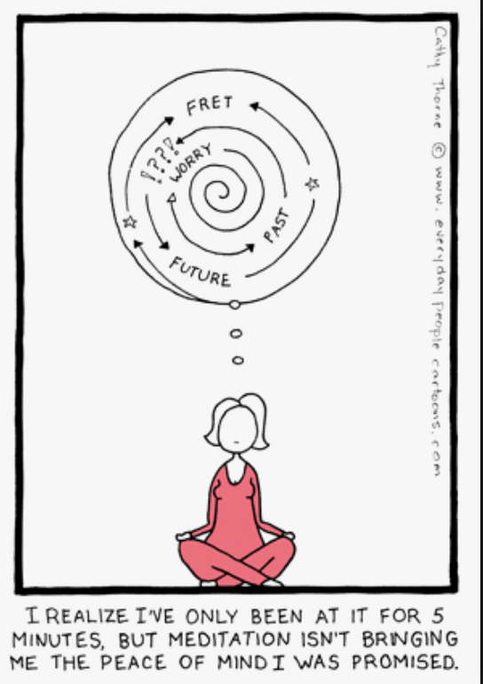
Is mindfulness thinking about nothing?
NO! Mindfulness meditation is paying attention in a systemic way to whatever you decide to focus on, which can include awareness of your thoughts.
By listening to your thoughts, you discover your habitual patterns.
Your thoughts have a large impact on your emotions and the decisions that you make so paying attention to them is helpful.

Slide 17
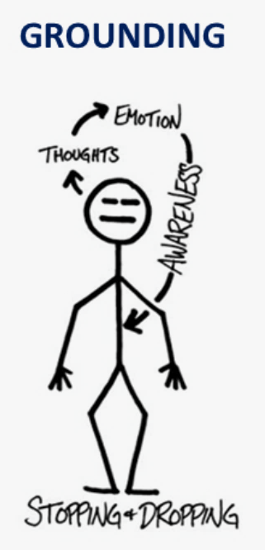
Do you meditate to relax?
The aim of mindfulness isn’t to make you feel more relaxed.
Trying to relax only causes more tension.
Mindfulness is accepting your moment by moment experience.
So if you are tense, mindfulness is being aware of that tension - Where do you feel tense? What’s it shape, colour, texture?
What’s your reaction to this tension, your thoughts?
Doing this often leads to relaxation, but it is not the aim
of the practise.

Slide 18
How does mindfulness help us to age well?
Mindfulness can reduce chronic pain and the emotional reaction to it. Recent research shows that pain ‘unpleasantness’ levels can be reduced by 57 per cent while accomplished meditators report reductions of up to 93 per cent.
Clinical trials show that mindfulness improves mood and quality of life in chronic conditions such as fibromyalgia and lower back pain, in chronic functional disorders such as IBS, and in challenging medical illnesses, including multiple sclerosis and cancer.
Mindfulness enhances mental and physical stamina and resilience.
Meditation and mindfulness improve control of blood sugar in type II diabetes.
Meditation improves heart and circulatory health by reducing blood pressure and lowering the risk of hypertension. Mindfulness reduces the risks of developing and dying from cardiovascular disease and lowers its severity should it arise.

Slide 19
How does mindfulness help us to age well?
Mindfulness is at least as good as medication or therapy for the treatment of clinical-level depression. Mindfulness-Based Cognitive Therapy (MBCT) is one of the preferred treatments recommended by the UK’s National Institute for Health and Clinical Excellence.
Mindfulness reduces addictive and self-destructive behaviour. These include the abuse of illegal and prescription drugs and excessive alcohol intake.
Meditation enhances brain function. It increases grey matter in areas associated with self-awareness, empathy, self-control and attention.
Mindfulness may reduce ageing at the cellular level by promoting chromosomal health and resilience.

Slide 20
Mindfulness as a preventative intervention
Mindfulness has been demonstrated to enhance many forms of cognition that are known to decline with age such as working memory along with many forms of attention.
Researchers have proposed that given mindfulness’ ability to strengthen attention, there is good justification for developing mindfulness groups to halt the deterioration from mild cognitive impairment to dementia (Robertson, 2015)
It reduces some of the thinning of certain areas of the brain that naturally occurs with ageing, and increases hippocampal volume.
Meditation improves the immune system. Regular meditators are admitted to hospital far less often for cancer, heart disease and numerous infectious diseases.

Slide 21
Mindfulness for carers
Dementia care giving presents serious cognitive, emotional, relational, and role challenges to family caregivers (e.g., Savla, Roberto, Blieszner, Cox, & Gwazdauskas, 2011)
Confers psychological and physical health risks, including higher risks of both psychiatric morbidity and mortality (Capistrant et al., 2012)
Interventions that contribute to maintaining the mental and physical health of family caregivers can contribute to greater quality of life (Mittelman, 2005).

Slide 22
Carers and cognitive functioning
Caregivers experience cognitive slowing that is mediated by depression( Vitaliano et al., 2009 ) and declines in vocabulary that are mediated by metabolic risk factors and hostility ( Vitaliano et al., 2005 ).
Caregivers show immediate memory deficits (Lee, Kawachi, & Grodstein, 2004 ), along with deficits in attention and aspects of episodic memory that require attentional processes, including learning and memory monitoring ( Mackenzie, Smith, Hasher, Leach, & Behl, 2007 ).
For carers of people with dementia mindfulness groups have been shown to significantly improve depression, perceived stress, and mental health-related quality of life (Liu et al., 2017).

Slide 23
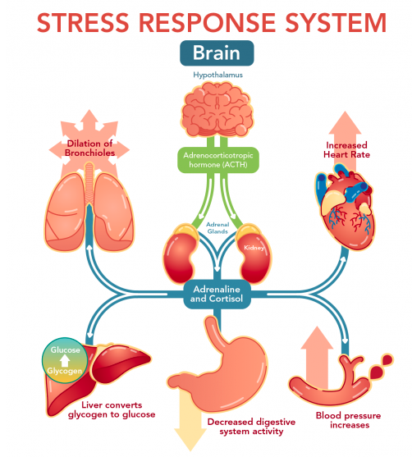
How does mindfulness work on all these areas at once?

Slide 24
Stress Response
Central Nervous System
Perception - Narrowed
Memory - Coarse, Imprecise
Learning - Blocked
Conditioning - Defense
Tendency - Regress or Perseverate
Tone – Fight or Flight
Autonomic Nervous System
Heart rate increases
Blood pressure increases
Oxygen need increases
Breathing rate increases
Palms, face sweat
Blood sugar increases
Adrenalin flows
Digestive tract shuts down blood to muscles
Blood vessels constrict in hands, face
Muscular System
Tension
Ready for Action
Jaws Clench
Body Braces for Action

Slide 25
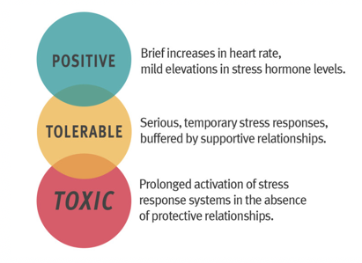
Is all stress bad?

Slide 26
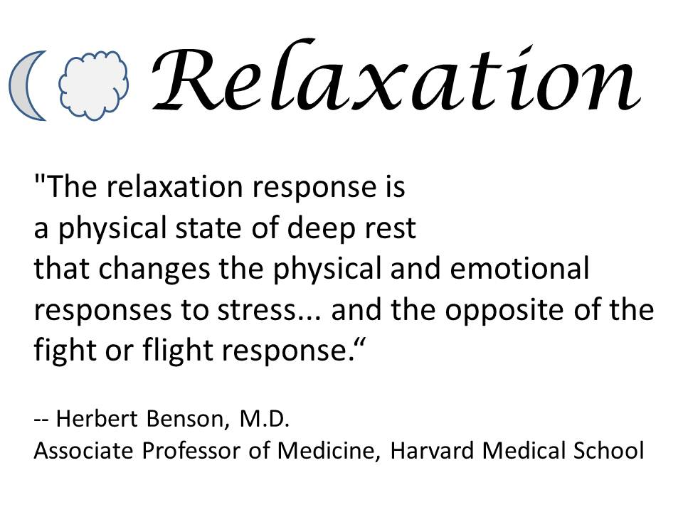
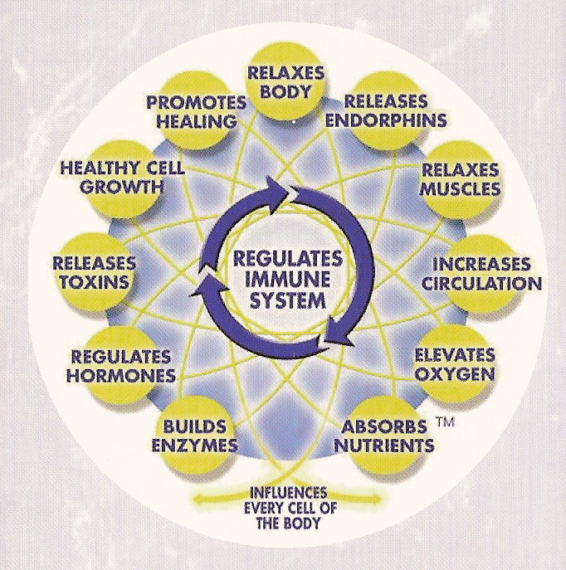
Resetting the stress response

Slide 27
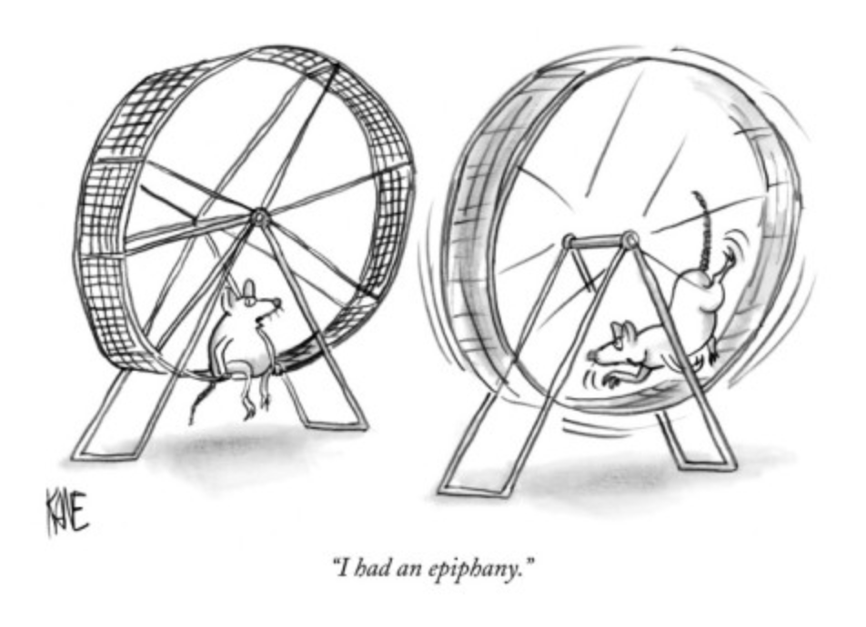
Mindfulness for later life group

Slide 28
Mindfulness for later life
Six sessions delivered online during the three COVID-19 national lockdowns
For patients, carers and the general public
Supports people to develop their own home practice
Teaches a range of mindfulness practices in a systematic way
Based on the MBSR programme, with some adaptations for older adults.

Slide 29
Outcomes from the groups
Marked improvement in compassion for self and others
For people with clinically significant levels of depression, these typically dropped from the moderate to severe range to the mild range.
For people without depression the scores either stayed the same or they reported increased awareness of sad mood, but remained in the subclinical range
For people whose memory difficulties were anxiety or depression related, they showed an improvement in working memory scores
All participants showed an increase in mindfulness skills and awareness

Slide 30
Feedback from the groups
“I began to open up my own mind and be less scared about everything.“
“… Having been shielding… It’s been relaxing. You know, and I thoroughly enjoyed it and I’m grateful for it’
“I’m beginning to find all kinds of things to be grateful for”

Slide 31
What was it like attending the group online?
“I felt more comfortable being in my own surroundings“
‘because of my chronic condition it’s hard for me to stick to stuff and actually go out and do it so I found it really helpful.”
“it’s a strange sort of dichotomy in a way because in one sense we were less together because we were not face-to-face, but on the other hand were in everyone else’s home, so I kind of in a sense felt more connected.”

Slide 32
Buddha quote…
“ the secret of health for the mind and body is not to mourn for the past, worry abut the future, or anticipate troubles, but to live in the present moment wisely and earnestly.”

Slide 33
Where can I access Mindfulness Courses?
British Association for Mindfulness based approaches holds a list of UK registered mindfulness teachers. https://bamba.org.uk
Many courses are now being run online due to COVID restrictions. Look for courses that are based on MBSR or MBCT.
If you have some cognitive or attention difficulties, look at one of the courses which has shorter practices, such as finding peace in a frantic world
There are several books with CDs which can help you to establish your home practice. “Full catastrophe living” by Jon Kabat Zinn outlines the MBSR approach. Danny Penman and Mark Williams have written “Finding Peace in a Frantic World.”

Slide 34
Thank you for your attention ☺
Please share your feedback here https://www.surveymonkey.co.uk/r/59SLCH6

Slide 35
Acknowledgements
Gatehouse Charity East Anglia
Suffolk Community Foundation
Norfolk Community Foundation
West Suffolk Clinical Commissioning Group
Centre for Mindfulness Research and Practice – University of Bangor.

Slide 36
Move it and breathe (Jitka Vseteckova & Declan Ryan) May 19th 2021

Slide 37
Summary of related resources to The Ageing Well Public Talk Series
Podcasts
Vseteckova J & King J (2020) COVID-19 Interview podcast for The Retirement Café: ‘Ageing Well Under Lockdown’ https://theretirementcafe.co.uk/077-dr-jitka/
Vseteckova J & Broad E (2020) Keep Me Walking - researching with people living with dementia and their carers - Podcast – Open University in collaboration with The Parks Trust https://youtu.be/0QHAS88C-LU
Vseteckova J (2020) Podcast - areas for research with The Open University https://youtu.be/vE6J9J_ovOM
Broad E & Methley A & Vseteckova J (2021) Podcast OU & The Parks Trust & Northamptonshire Healthcare NHS Foundation Trust - Spotter sheet and mindful walking. https://www.youtube.com/watch?v=dq5OXEBk3CA&feature=youtu.be
Broad E & Methley A & Vseteckova J (2021) Ageing Brain - just recorded

Slide 38
Ageing well related
Vseteckova J (2020) Ageing Well Public Talk Series https://www.open.edu/openlearn/health-sports-psychology/health/the-ageing-well-public-talks
Vseteckova J (2019) 5 reasons why exercising outdoors is great for people who have dementia https://www.open.edu/openlearn/health-sports-psychology/mental-health/5-reasons-why-exercising-outdoors-great-people-who-have-dementia
Vseteckova J (2019) Depression, mood and exercise https://www.open.edu/openlearn/health-sports-psychology/mental-health/depression-mood-and-exercise?in_menu=622279
Vseteckova J (2019) Five Pillars for Ageing Well https://www.open.edu/openlearn/health-sports-psychology/mental-health/five-pillars-ageing-well
Vseteckova J (2020) Ageing Brain https://www.open.edu/openlearn/health-sports-psychology/health/the-ageing-brain-use-it-or-lose-it
Vseteckova J (2020) Ageing Well Public Talks Series II. Plan for 2020 – 2021 https://www.open.edu/openlearn/health-sports-psychology/health/ageing-well-public-talk-series-plan-2020/2021
Vseteckova J (2020) Walking the Parks with The OU and The Parks Trust https://www.open.edu/openlearn/health-sports-psychology/social-care-social-work/keep-me-walking-people-living-dementia-and-outdoor-environments
Vseteckova J, Borgstrom E, Whitehouse A, Kent A, Hart A (2021) Advance Care Planning (ACP ) - Discuss, Decide, Document and Share Advance Care Planning (ACP ) - Discuss, Decide, Document and Share - OpenLearn - Open University
Vseteckova J, Methley A, Lucassen M (2021) The benefits of mindfulness and five common myths surrounding it https://www.open.edu/openlearn/health-sports-psychology/mental-health/the-benefits-mindfulness-and-five-common-myths-surrounding-it

Slide 39
COVID-19 and/or Caring related
Vseteckova J, How to age well, while self-isolating (2020) https://www.open.edu/openlearn/health-sports-psychology/how-age-well-while-self-isolating
Vseteckova J, (2020) SHORT FILM - Ageing Well in Self-Isolation https://youtu.be/LU4pXFgcGos
Vseteckova J, (2020) ANIMATION - Keeping healthy in Self-Isolation https://youtu.be/M9yUC-MUugA
Vseteckova J et al (2020) COVID-19 The effects of self-isolation and lack of physical activity on carers https://www.open.edu/openlearn/health-sports-psychology/social-care-social-work/the-effects-self-isolation-and-lack-physical-activity-on-carers
Taverner P, Larkin M, Vseteckova J, et al. (2020) Supporting adult carers during COVID-19 pandemic https://www.open.edu/openlearn/health-sports-psychology/social-care-social-work/how-can-adult-carers-get-the-best-support-during-covid-19-pandemic-and-beyond
Robb M, Penson M, Vseteckova J, et al. (2020) Young carers, COVID-19 and physical activity https://www.open.edu/openlearn/health-sports-psychology/social-care-social-work/young-carerscovid-19-and-physical-activity
Vseteckova J et al. (2020) Carers, COVID19 and Physical Activity: The research https://www.open.edu/openlearn/health-sports-psychology/social-care-social-work/carers-covid-19-and-physical-activity-the-research
Penson M, Vseteckova J et al. (2020) Older Carers, COVID-19 and Physical Activity https://www.open.edu/openlearn/health-sports-psychology/social-care-social-work/older-carers-covid-19-and-physical-activity
Methley A & Vseteckova J & Jones K (2020) Green & Blue & Outdoor spaces https://www.open.edu/openlearn/health-sports-psychology/mental-health/the-benefits-outdoor-green-and-blue-spaces
Vseteckova J & Methley A (2020) Acceptance Commitment Therapy (ACT) to help carers in challenging COVID-19 times https://www.open.edu/openlearn/health-sports-psychology/health/how-can-acceptance-and-commitment-therapy-help-carers-challenging-times-such-the-covid-19-pandemic

Slide 40
‘Ageing Well Public Talks’ Series 2020/2021 repository on ORDO Collections
https://ordo.open.ac.uk/collections/Ageing_Well_Public_Talks_2020-21/5122166
‘Ageing Well Public Talks’ Series 2019/2020 repository on ORDO Collections https://doi.org/10.21954/ou.rd.c.4716437.v1
OpenLearnCreate Course on ‘Ageing Well’ 2019/2020 https://www.open.edu/openlearncreate/course/view.php?id=5016
Home exercise no equipment – no problem Blog
https://selsdotlife.wordpress.com/2020/04/01/home-exercises-for-older-adults-no-equipment-no-problem/

